Slide 1
LEARNING BY DOING Learning by doing is a methodology proposed by Dewey. It consists in giving to students an active role in the process of building knowledge. The role of the teacher is a guide that facilitates their learning.

Slide 2
Computational thinking
Computational thinking means a mental process that allows to solve problems of various kinds by following specific methods and tools by planning a strategy.

Slide 3
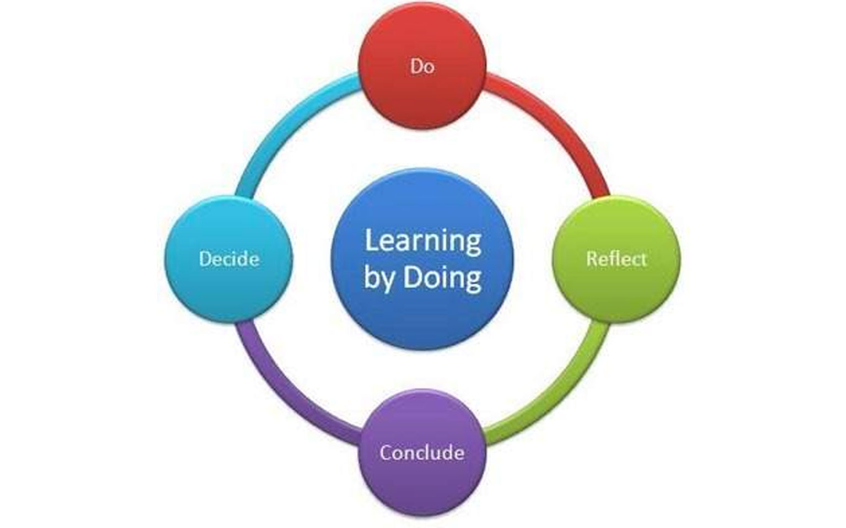
LEARNING BY DOING

Slide 4
PROBLEM SOLVING
Problem solving is a technique that consists in trying to resolve a problematic situation. The phases are:
1)Define the goal
2)Recognize the problem
3)Hypothesize possible solutions
4)Choose the best solution
5)Solve the problem

Slide 5
Problem solving strategies

Slide 6
BRAINSTORMING
What is brainstorming?
Brainstorming is an activity that encourages students to focus on a topic and to collect ideas about it. Every participant is encouraged to think aloud and suggest as many ideas as possible

Slide 8
TUTORING
The tutoring is a way to manage the class that consists of submitting to one or more students responsibility for a part of the educational program. It promotes accountability, inclusion and development of social skills. In addition the students are at an age where they prefer to work with peers

Slide 9
PEER TUTORING

Slide 10
Peer Tutoring
Peer tutoring is a teaching strategy wherein students are paired together to practice academic skills and master content..
Peer tutoring often helps students build relationships and practice appropriate social interaction.
Peer tutoring can increase the self-esteem of tutor.

Slide 11
ROLE PLAYING

Slide 12
ROLE PLAY
In the role play students act a role and bring themselves into the shoes of another person. It makes the learning easier and more enjoyable.

Slide 13
ROLE PLAY

Slide 14
DEBRIEFING
Debriefing is a methodology that consists of a self critical reflection on what has been done and learned about a topic.

Slide 15
REFLECTIVE PRACTICE
Reflection in action
Reflection on action

Slide 16
COOPERATIVE LEARNING

Slide 17
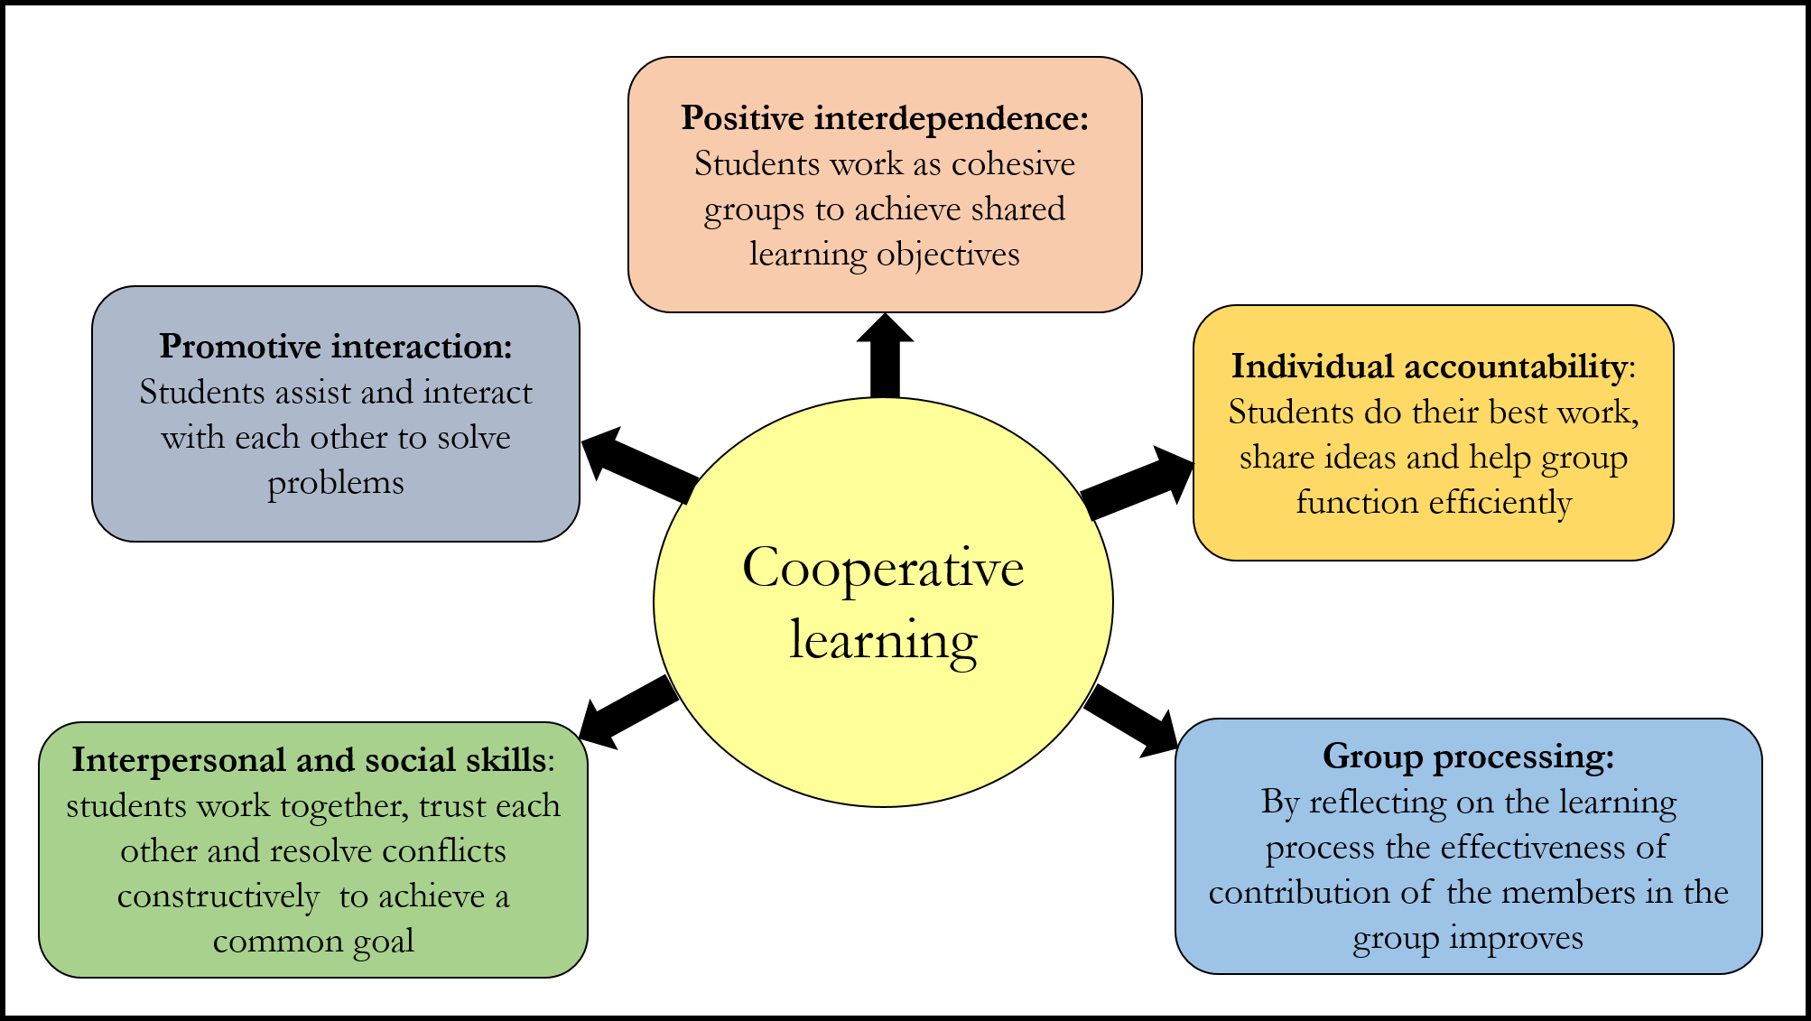
Cooperative learning: how it works

Slide 19
METHODOLOGY: Definition
A system of methods used in a particular area of study or activity.

Slide 20
METHOD: Definition
A set of classroom activities for accomplishing learning objectives.

Slide 21
TECHNIQUE: Definition
The way and the ability that a teacher employs to achieve a desired result

Slide 22
METHOD AND TECHNIQUE

Slide 23
CIRCLE TIME
Circle time is a technique which consists in putting the students in a circle to talk in turn to various topics. It’s useful to resolve conflicts, know each other better, solve a problem and develop emotional intelligence. Circle time is useful to improve interpersonal relationship.

Slide 24
THE IMPORTANCE OF TECHNOLOGIES
The advantages of digital technologies are: interactivity, multimedia, development of computational thinking, ability to be compensatory tool for various type of special educational needs, gives immediate feedback.
SEN ( Special educational needs)(BES)
SLD= Specific learning difficulties( DSA)

